Slide 1

Airport Authority Data Analysis
POWERBI PROJECT
BY ELMA FORTUNATE PHIRI
©FortunateCreations

Slide 2
This project aims to analyze the total number of flights (incoming and departing flights), the total number of flight delays (arrivals and departures), ground processing time
This analysis could assist airport management authorities in making timely data-driven choices
Data Source
US Airline delays and cancellation dataset 2009-2018
Introduction
©FortunateCreations

Slide 3
Objectives
Analyze the total number of incoming and departing flights to provide a complete picture of airport traffic.
Examine the total number of flight delays, both for arrivals and departures, to understand the extent of disruptions.
Assess ground processing time to identify potential bottlenecks and areas for optimization.
©FortunateCreations

Slide 4
Overview
Data Loading
Data Transformation
Time Series Analysis
Trend Analysis
Dashboard
Insights
Recommendation
Reference and Acknowledgements
©FortunateCreations

Slide 5
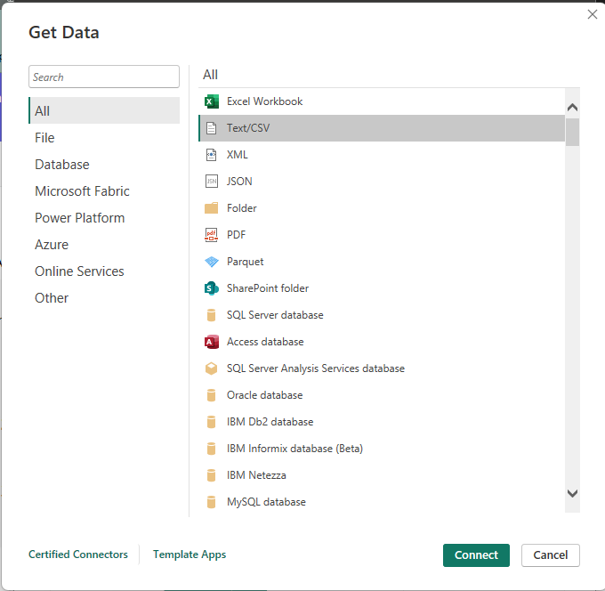
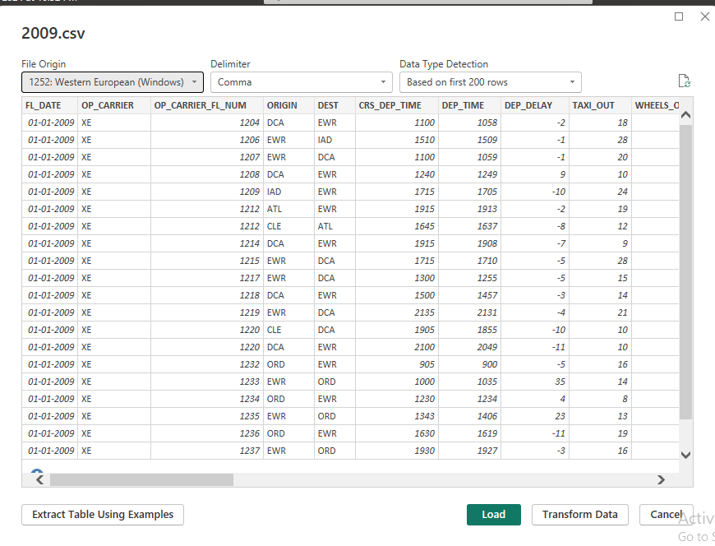
  DATA LOADING
©FortunateCreations

Slide 6
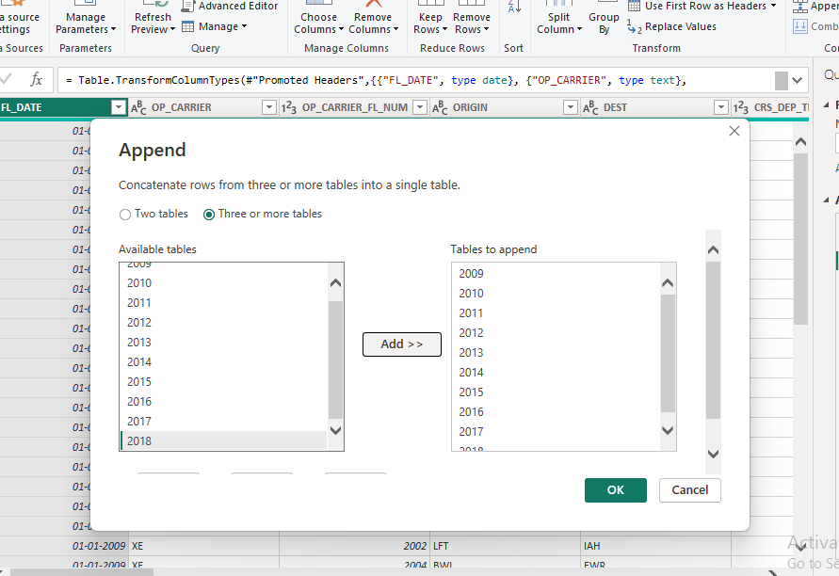
APPENDING DATASETS
The US Airline delays and cancellation dataset contains 10 different datasets grouped according to the years 2009-2018. We first had to append these datasets into one dataset to facilitate easy analysis of the data.
©FortunateCreations

Slide 7
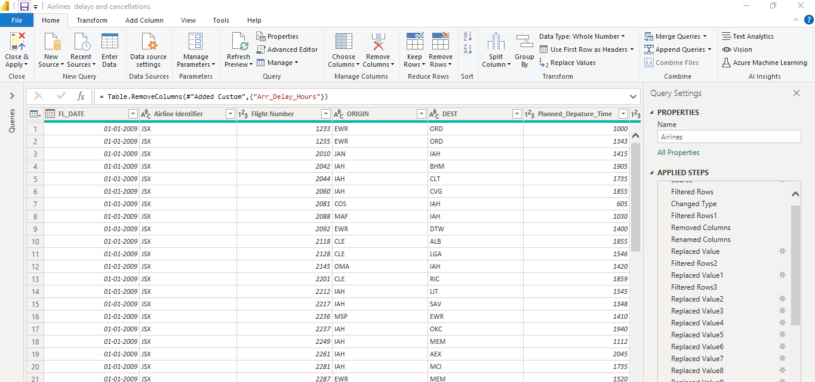
DATA TRANSFORMATING
Filtered Rows
Removed unnecessary Columns
Renamed Header Columns
Replaced values
©FortunateCreations

Slide 8
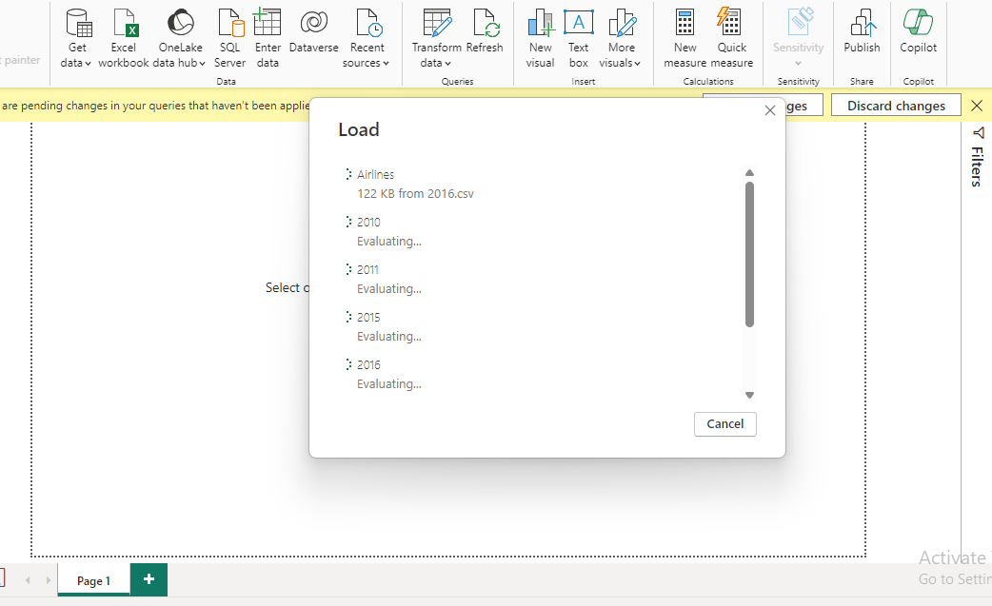
Data Loading after transforming it
©FortunateCreations

Slide 9
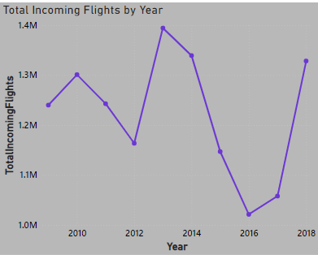
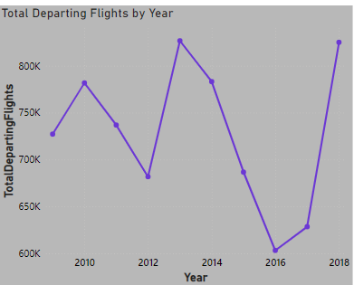
TIME SERIES ANALYSIS
Analyzed the number of flights over time
Chart Type: Line Chart
Conclusion:
The highest number of incoming flights is 1 394 259 and departing flights is 826 690 both in the year 2013
©FortunateCreations

Slide 10
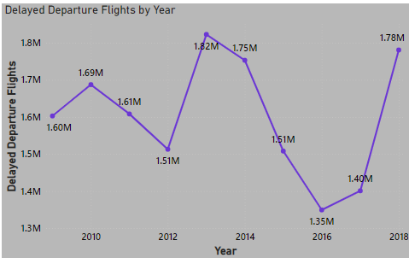
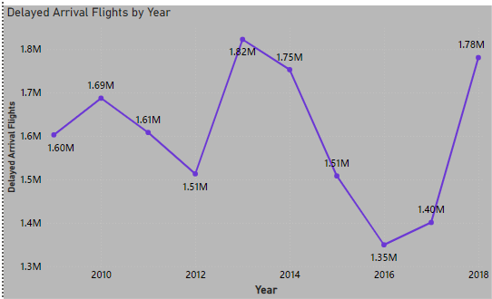
Analyzed the number of delayed flights over time
Chart Type: Line Chart
Conclusion:
The highest number of delayed arrival and departing flights is 1823 059 both in the year 2013
©FortunateCreations

Slide 11
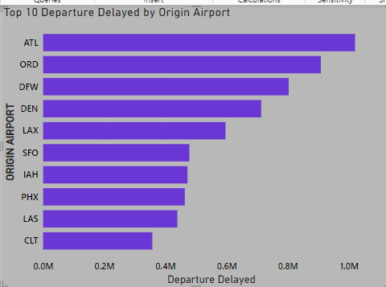
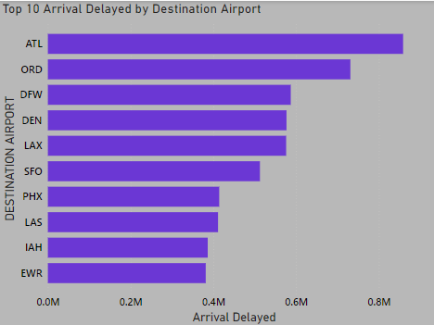
TREND ANALYSIS
Analyzed the top 10 delayed flights by Airports
Chart Type: Clustered Bar Chart
Conclusion:
The most delayed flights were from the ATL airport followed by ORD airport
©FortunateCreations

Slide 12
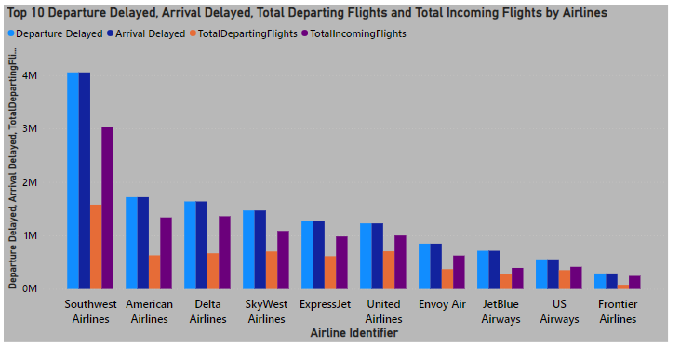
Analyzed the number of delayed flights , total incoming and departing flights by Airlines
Chart Type: Clustered Column Chart
Conclusion:
The Airline with the most flight delays, most flights is Southwest Airlines
©FortunateCreations

Slide 13
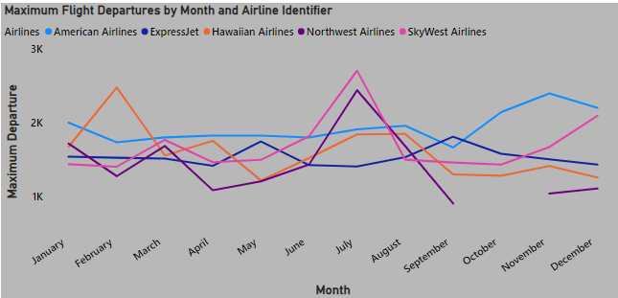
TREND ANALYSIS
Analyzed the maximum flight departures by month and Airlines
Chart Type: Line Chart
Conclusion:
The maximum flight departures occurred in the month of July and SkyWest Airlines had the most flights at 2 710 followed by Northwest Airlines with 2 445
©FortunateCreations

Slide 14
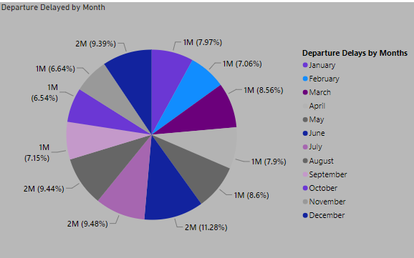
Analyzed Departure delays by months
Chart Type: Pie Chart
Conclusion:
The most flight delays occurred in the month of June with 11.28% of the total proportion
©FortunateCreations

Slide 15
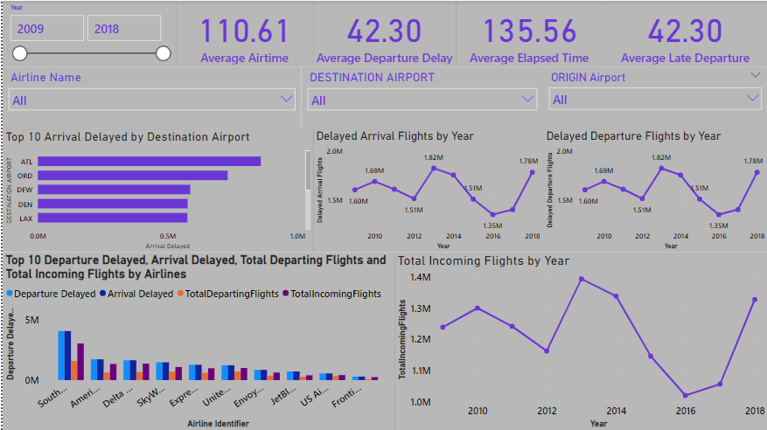
DASHBOARD
©FortunateCreations

Slide 16
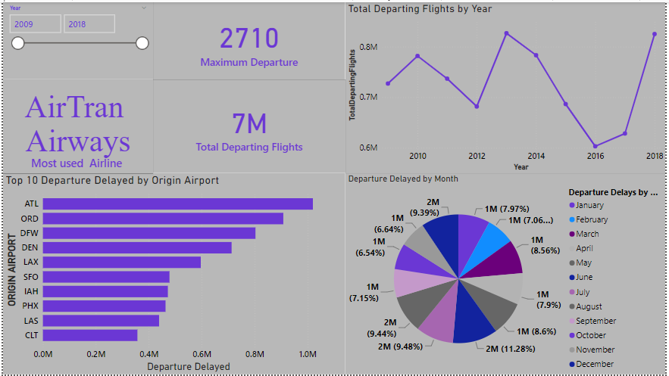
DASHBOARD
©FortunateCreations

Slide 17
Summary and Key Insights
US Airline delays and cancellation dataset 2009-2018 reveals the following key insights:
The highest number of incoming flights is 1 394 259 and departing flights is 826 690 both in the year 2013
The highest number of delayed arrival and departing flights is 1823 059 both in the year 2013
The most delayed flights were from the ATL airport followed by ORD airport
The Airline with the most flight delays, most flights is Southwest Airlines
The average Airtime is 110.61
The average departure delay is 42.30
©FortunateCreations

Slide 18
RECOMMENDATIONS
•Actionable Recommendations:
Use predictive analytics to identify and mitigate potential bottlenecks. Ensure that flight schedules have sufficient buffers to accommodate minor delays without cascading into major issues.
Implement more efficient boarding processes to reduce the time taken for passengers to board and disembark
©FortunateCreations

Slide 19
REFERENCE AND ACKNOWLEDGEMENTS
•References:
US Airline delays and cancellation dataset 2009-2018
List of airlines of the United States Wikipedia
•Acknowledgements:
Many thanks to mentors, colleagues, and data providers.
©FortunateCreations

Slide 20
©FortunateCreations

